Slide 1








FINANCIAL
ANALYTICS
~ Rupal Kanchan
Data Analyst Intern

Slide 2


Problem Statement
Without analyzing the competition, it is difficult for a business to survive. You are tasked to analyze the competition for the management to provide better results. This data set has information on the market capitalization of the top 500 companies in India.

Slide 3

Data Preparation
1. DATA IMPORT: Gathered data from UNIFIED MENTOR and imported it into Power BI for data transformation.
2. DATA TRANSFORMATION: Used Power Query to clean the data, removed nulls and duplicates, and Changed the data types.
3. DATA IMPLEMENTATION: I used different DAX functions to create calculated measures and columns, further refining the data for deeper insights.
4. DASHBOARD CREATION: Created a user-friendly dashboard that helps the organization make important decisions.

Slide 4

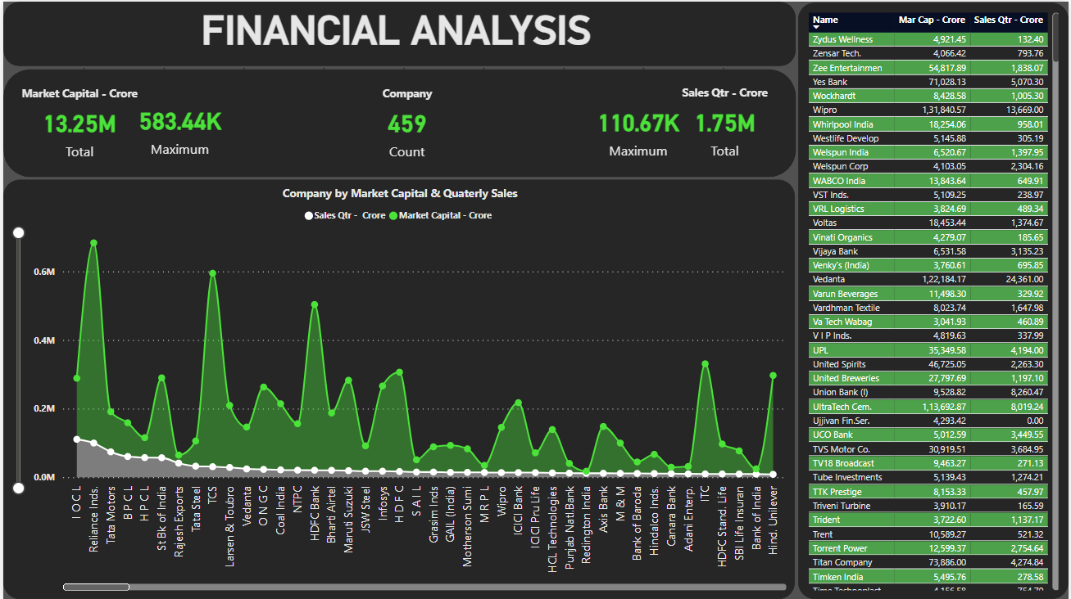
Dashboard Preview

Slide 5
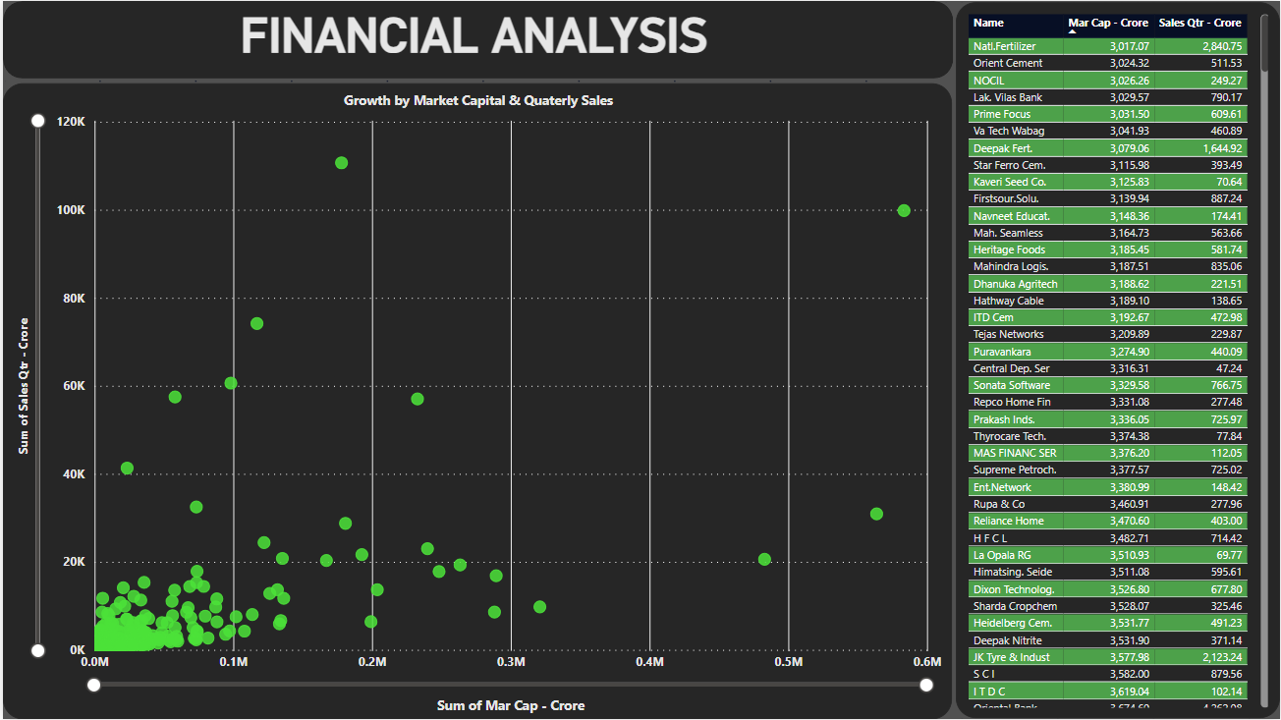
Dashboard Preview

Slide 6




01
Total Market Capital is Rs.13.25 Million Crores.
Total Quarterly Sales is Rs.1.7 Million Crores.
Insights
Max. Market Capital incurred by Reliance Industries of Rs. 593.44 Thousand Crores. Whereas, Max Quarterly Sales is marked by IOCL at Rs.110.67 Thousand Crores.
Min. Market Capital is flagged by Natl.Fertilizers for Rs.3.02 Thousand Crores and min quarterly sales is done by Ujjwan Fin.Ser. with 0 to No sale in the quarter.
02
There is a general positive correlation between market capital and quarterly sales. Companies with higher market capital tend to have higher quarterly sales.
03

Slide 7






Thank You

